Slide 1
MIMO-OFDM
Weekly Meeting: Week 3
Kate Bowers, Kristopher Jung, Samuel Spillane

Slide 2
Literature Review Overview
Experimental Study of Cooperative MIMO at HF Band was on the application of MIMO technology to HF and solutions to the problems inherent.
An Experimental Investigation Into the Feasibility of MIMO Techniques Within the HF Band looked into potential methodologies for the application of MIMO with HF.
From Theory to Practice: An Overview of MIMO Space–Time Coded Wireless Systems provides a general overview of MIMO technology and techniques as it currently stands
An Overview of MIMO Communications—A Key to Gigabit Wireless details the current state of MIMO technologies in the context of 5G internet.
Cognitive engine implementation for wireless multicarrier transceivers - presents a genetic-algorithm driven, cognitive radio decision engine that determines the optimal radio transmission parameters for single and multicarrier systems.

Slide 3
Literature Review Cont.
New Detection Schemes for Transmit Diversity with no Channel Estimation entertains using two transmission antennas and one receiving antennas.
A New MIMO HF Data Link: Designing for High Data Rates and Backwards Compatibility discusses compact cross-polarized arrays through measurements as a way to apply MIMO to HF.

Slide 4
Roadmap
Week 3
Implement Waterson channel model (Rayleigh Fading) in MATLAB (with data outputs)
Implement traditional estimation algorithms like RLS and LMS
Initial CE baseline algorithm design
Weeks 4-6
Design and implement CE algorithms (Genetic, Epsilon-greedy)
Test a variety of ML algorithms for improving the IO of our MIMO implementation
Week 7-10
Other tasks
paper writing

Slide 5
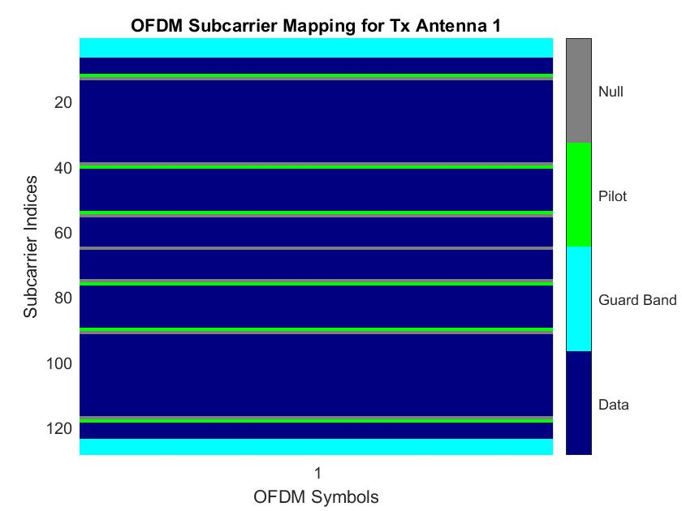
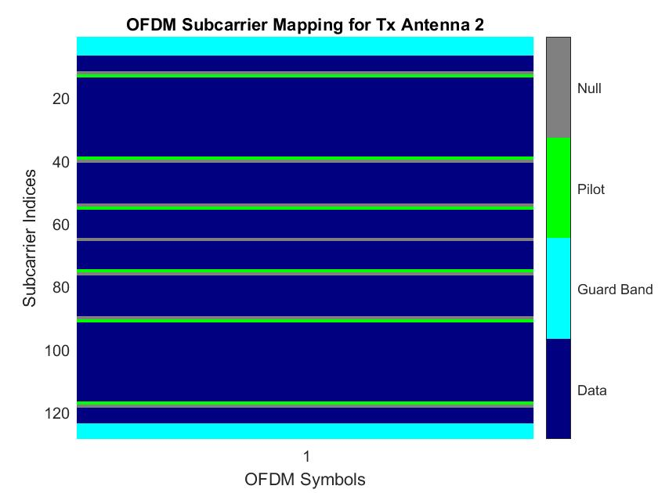

Our First Simulations- Credit of at Mathworks for their OFDM with MIMO Simulation
Notes:
QPSK modulation/demodulation + Rayleigh Fading + Least Square Solution to Fading channel

Slide 6
Questions?

Slide 7
References
Vasily Yu. Doroshenko, Inna O. Dvorakova, Alexander A. Malyutin, and Yuri B. Nechaev "Experimental Study of Co­operative MIMO at HF Band," in Proc. 36th International Conf. on Telecommunications and Signal Processing (TSP), Rome, Italy, 2013, pp 160-165.
S.D. Gunashekar, E.M. Warrington, S. Salous, W. Kassem, L. Bertel, D. Lemur, H. Zhang, and N. Abbasi "An Experimental Investigation Into the Feasibility of MIMO Techniques Within the HF Band," in 2nd European Conference on Antennas and Propagation, Edinburgh, UK, 2007.
D. Gesbert, M. Shafi, Da-shan Shiu, P. J. Smith and A. Naguib, "From theory to practice: an overview of MIMO space-time coded wireless systems," in IEEE Journal on Selected Areas in Communications, vol. 21, no. 3, pp. 281-302, April 2003.
A. J. Paulraj, D. A. Gore, R. U. Nabar and H. Bolcskei, "An overview of MIMO communications - a key to gigabit wireless," in Proceedings of the IEEE, vol. 92, no. 2, pp. 198-218, Feb. 2004.
T. R. Newman, B. R. Barker, A. M. Wyglinski, A. Agah, J. B. Evans, and G. Minden "Cognitive engine implementation for wireless multicarrier transceivers," in Cognitive engine implementation for wireless multicarrier transceivers, vol. 7, pp. 1129-1142, Nov. 2007.
V. Tarokh, S. M. Alamouti and P. Poon, "New detection schemes for transmit diversity with no channel estimation," ICUPC '98. IEEE 1998 International Conference on Universal Personal Communications. Conference Proceedings (Cat. No.98TH8384), Florence, Italy, 1998, pp. 917-920 vol.2.
R. C. Daniels and S. W. Peters, "A New MIMO HF Data Link: Designing for High Data Rates and Backwards Compatibility," MILCOM 2013 - 2013 IEEE Military Communications Conference, San Diego, CA, 2013, pp. 1256-1261.

